Slide 1

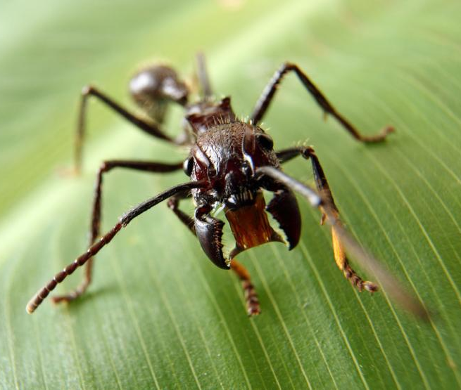
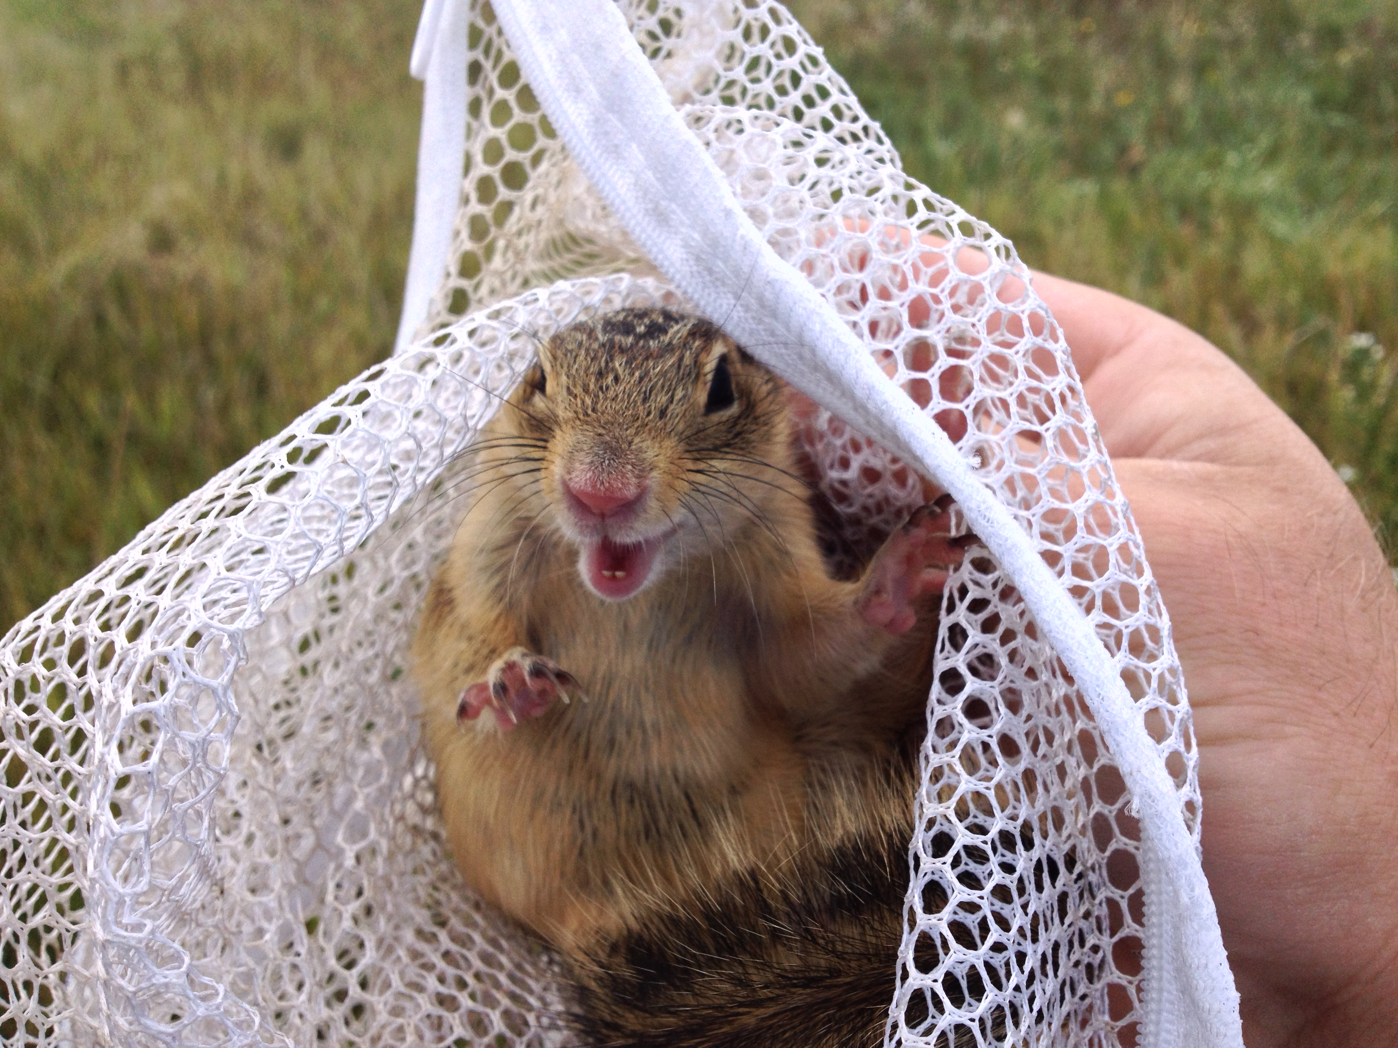

Estimating population and community parameters
2 November

Slide 2
To understand the relationships among species (and between species and their environment) we need to know:
How many individuals of a species are present in an area
How many species are present in an area
The relative representation of species in an area
The diversity of species present at different spatial scales

Slide 3
How many unicorns are there?
How do we know?

Slide 4
How many individuals are present in an area?
Transect sampling
Quadrat sampling
Trapping (Capture – Mark – Recapture)
Camera Trapping

Slide 5
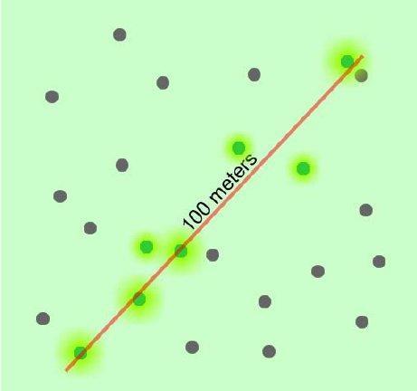
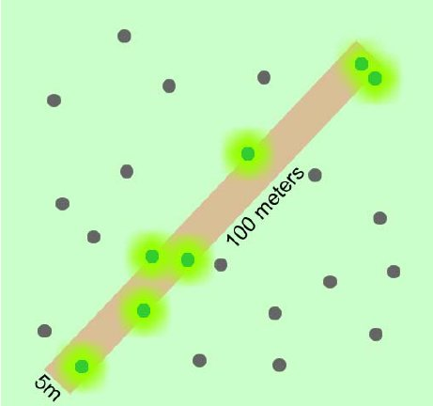
Transect Sampling
Carthy et al. (2005)

Slide 6
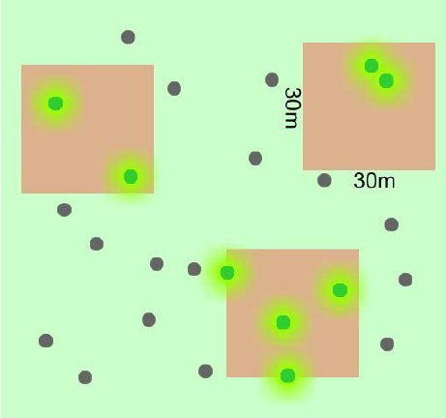
Quadrat Sampling
>
Carthy et al. (2005)

Slide 7
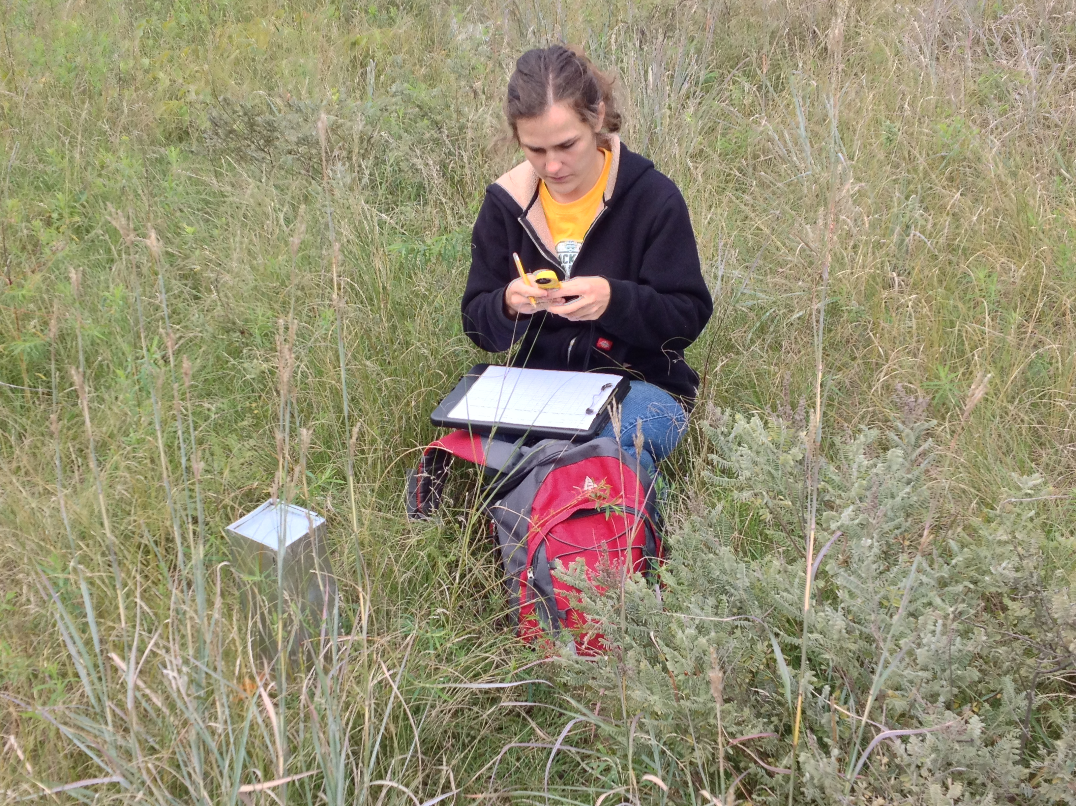
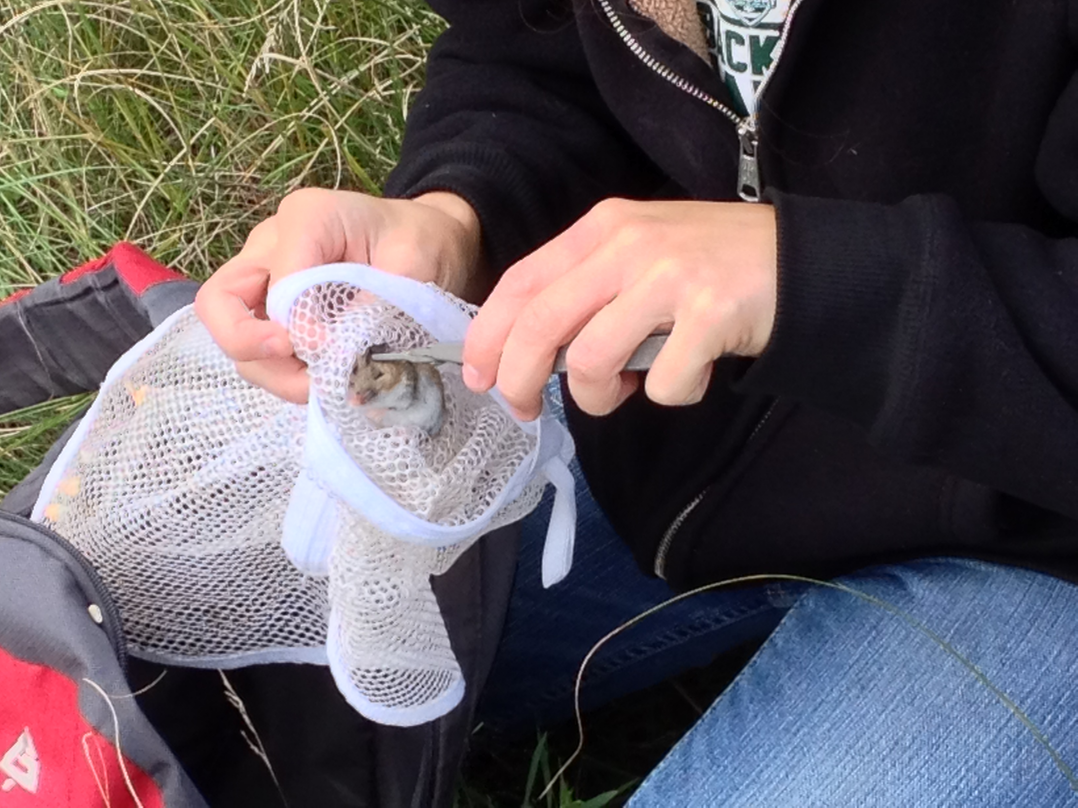
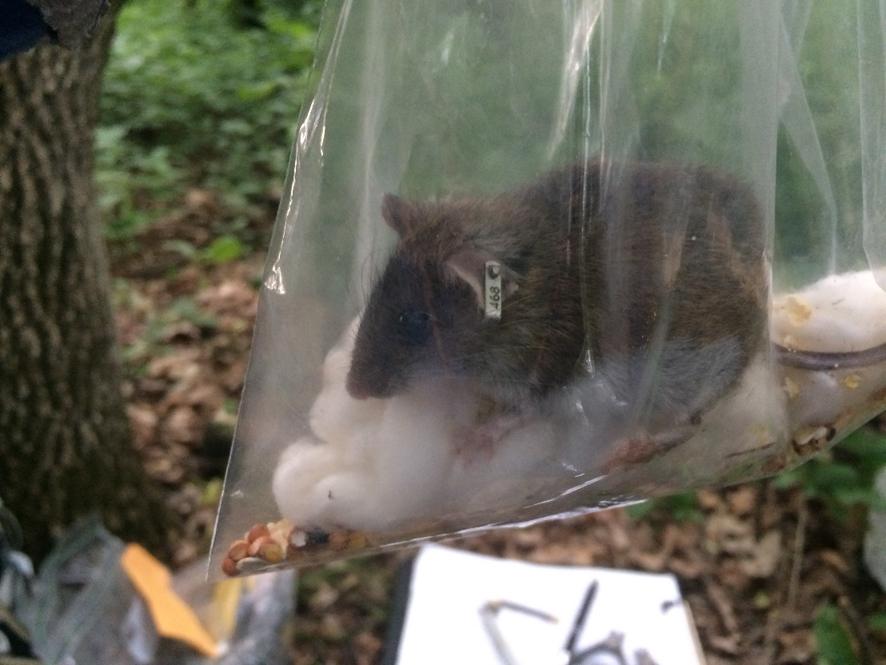
Trapping
Capture!
Mark!
Recapture!

Slide 8
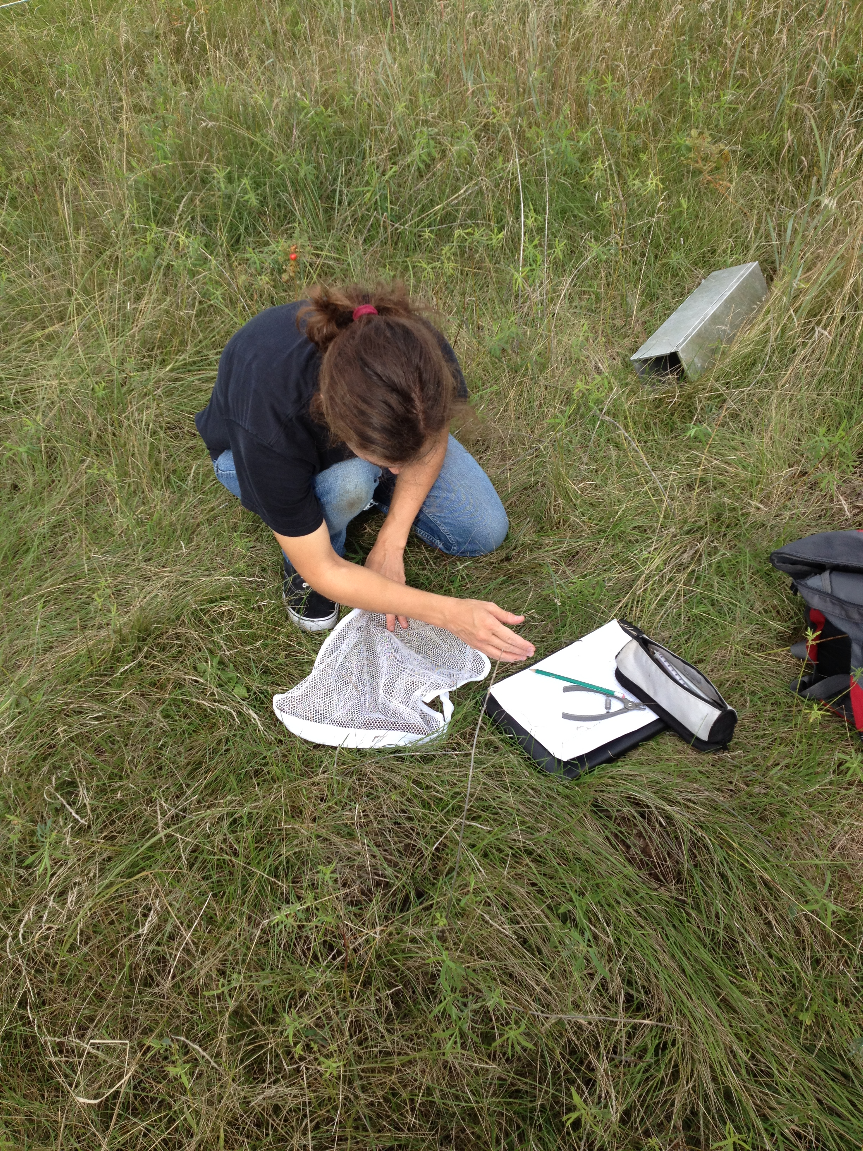
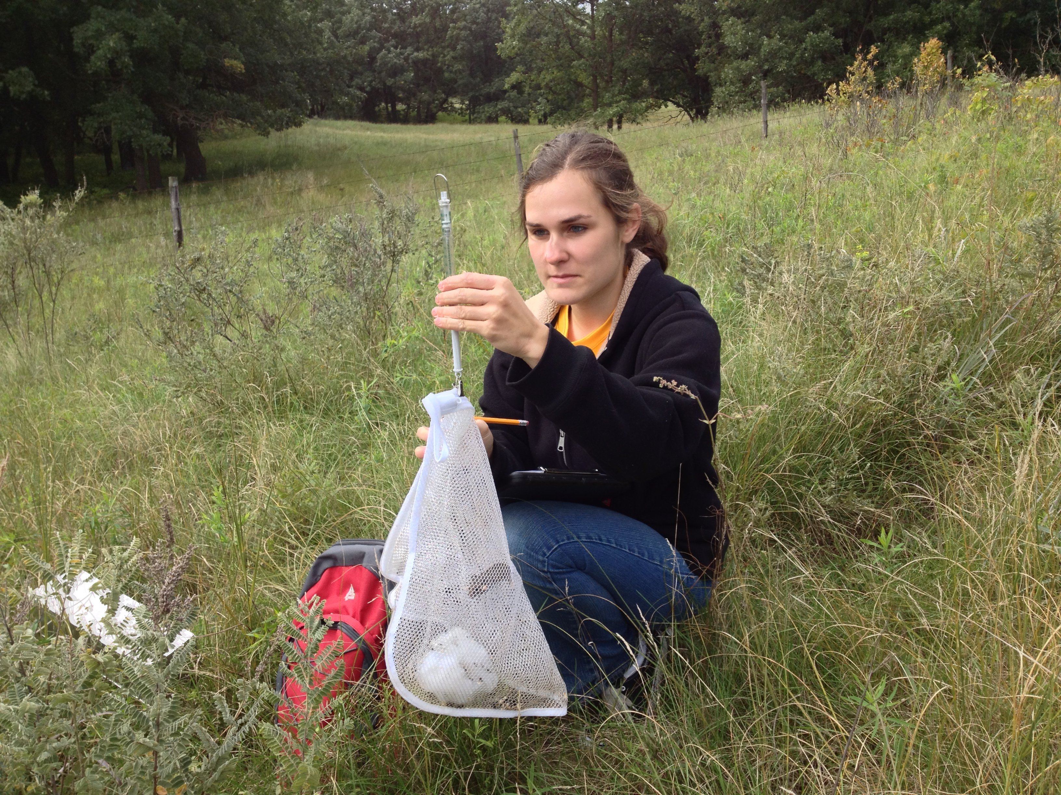

Slide 9

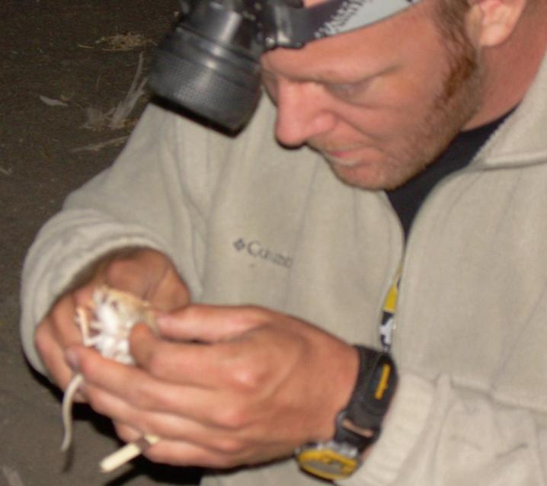

Slide 11
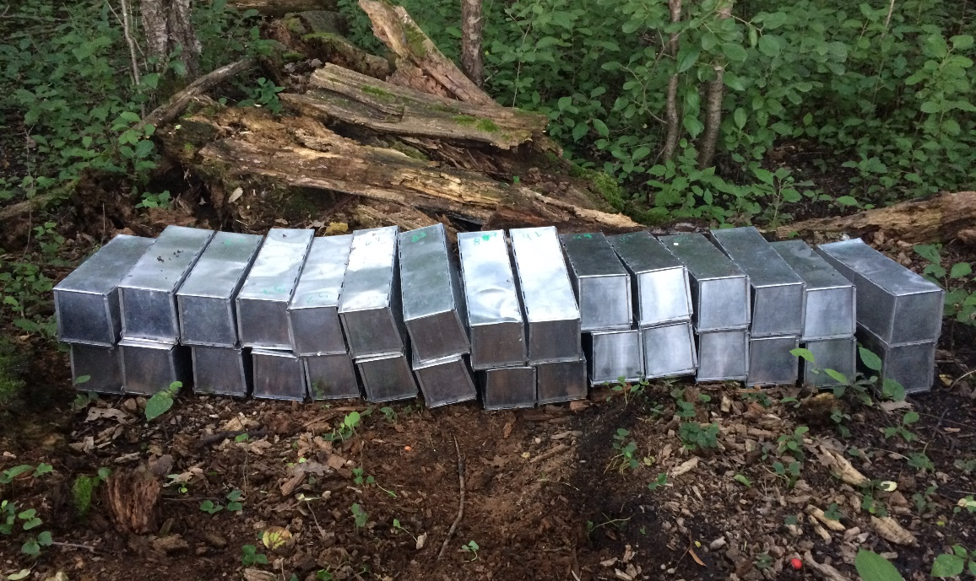

Slide 12
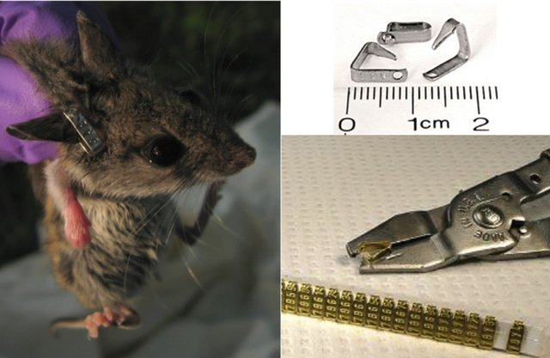

Slide 13
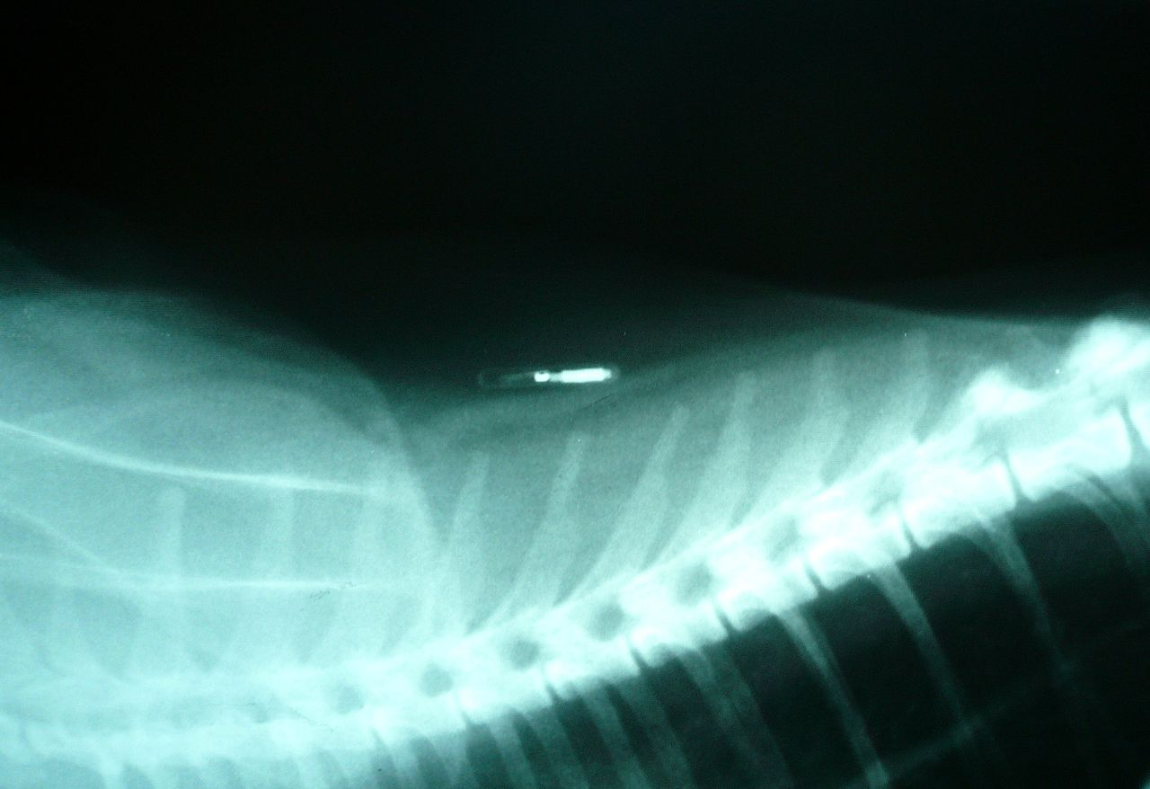
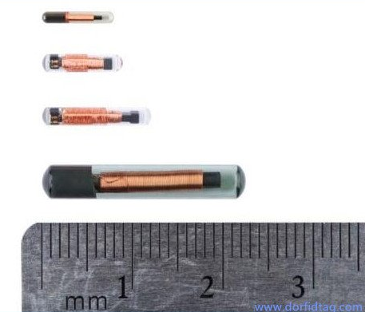

Slide 14
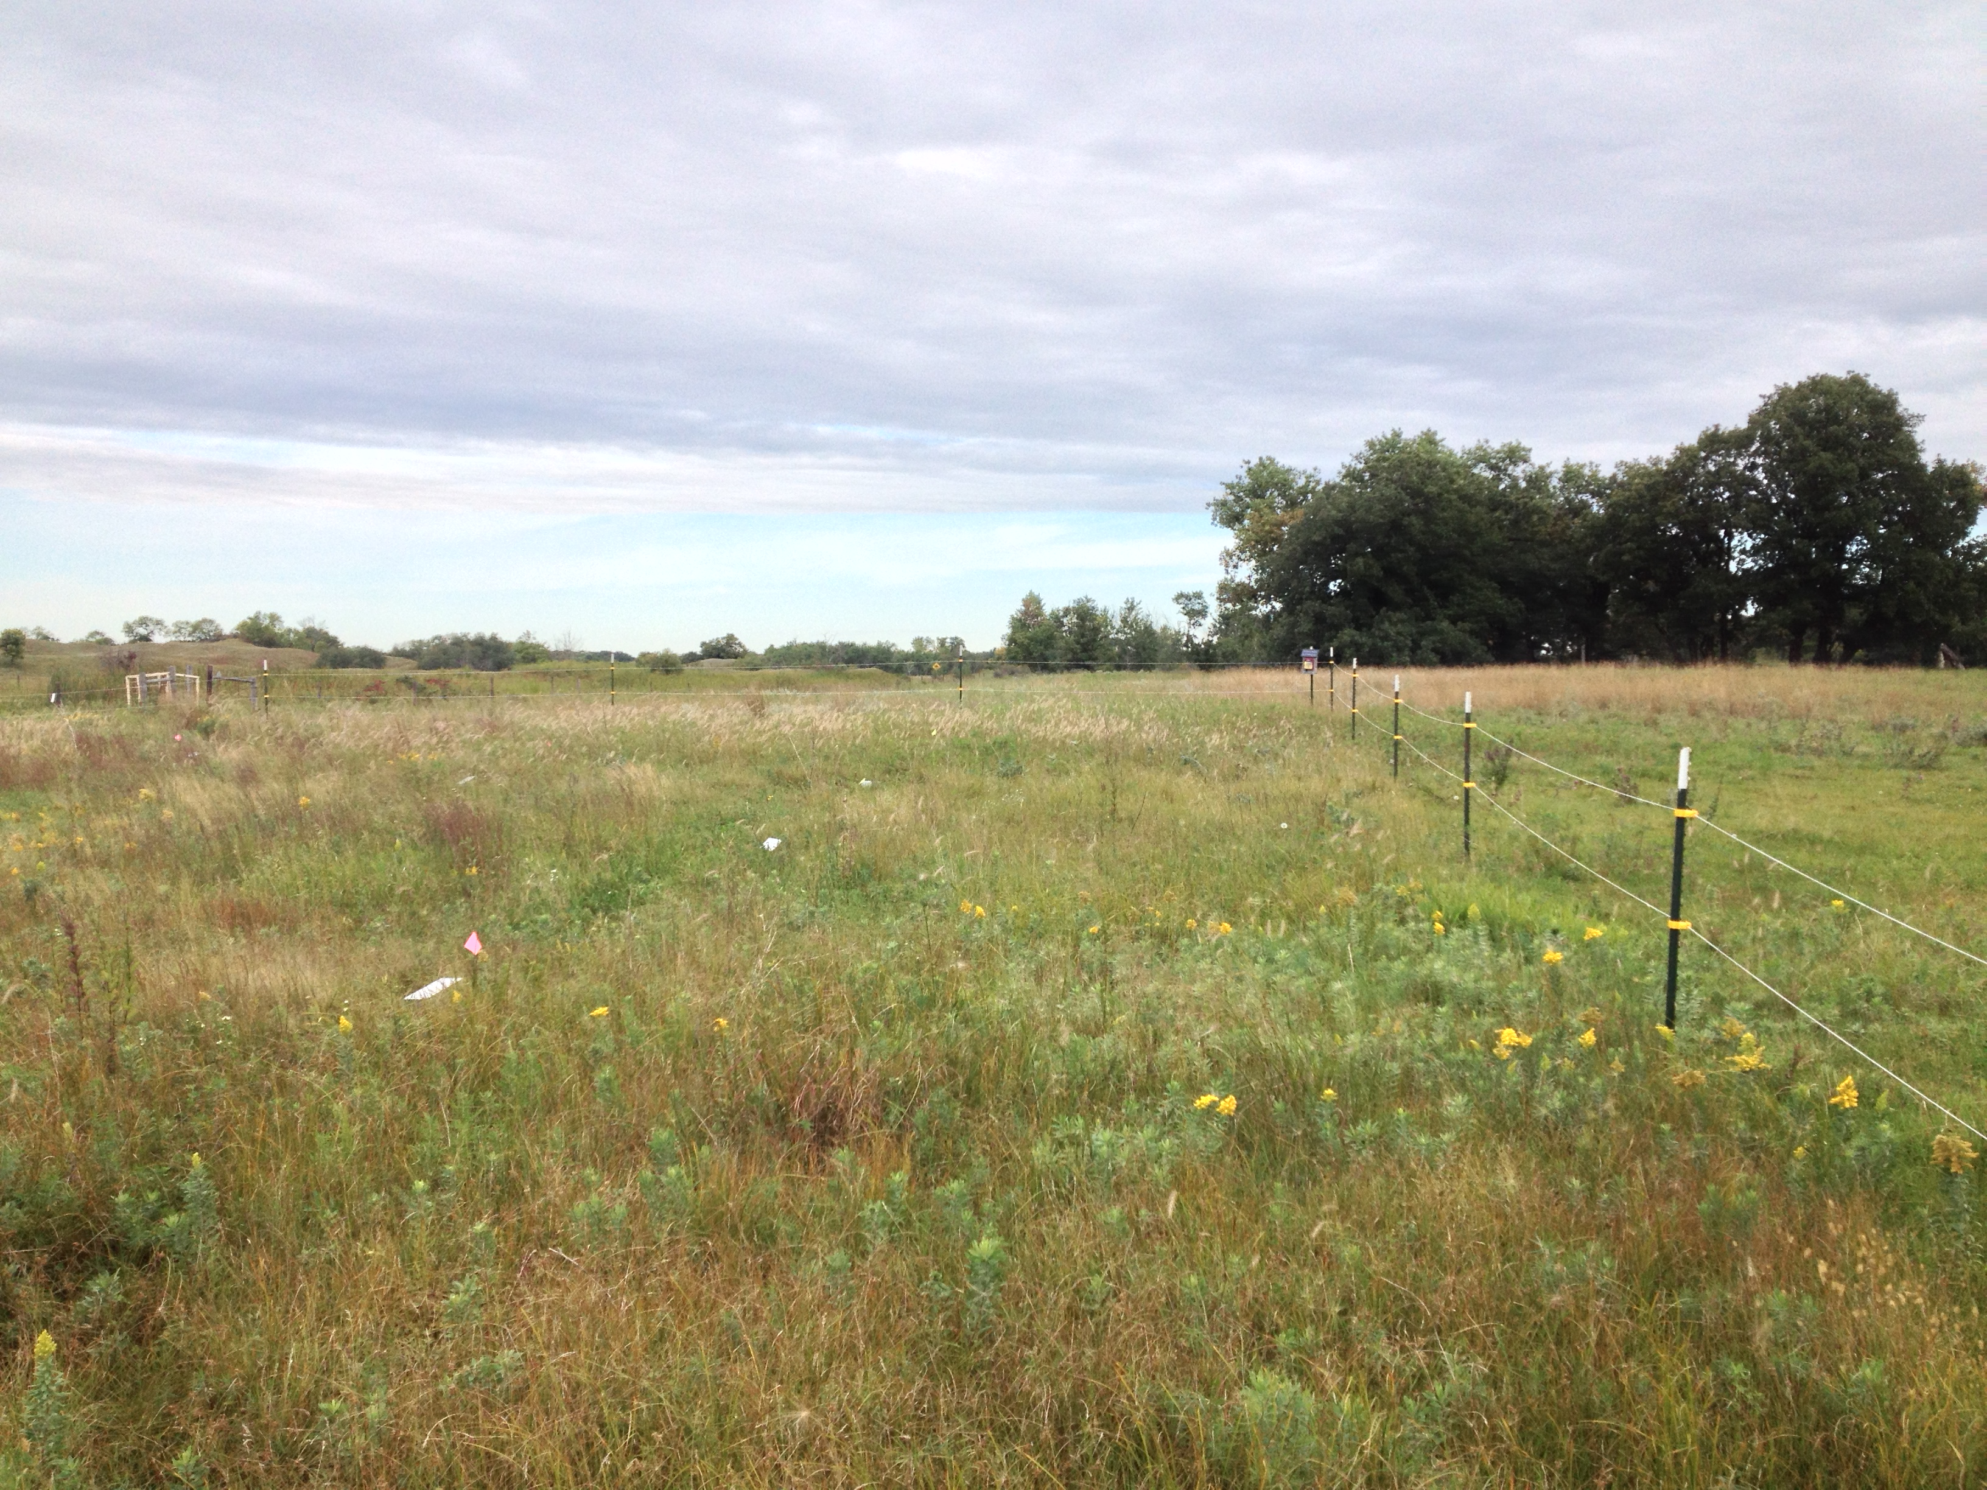

Slide 15
- | - | - | - | - | - | - | - | - | -
- | - | - | - | - | - | - | - | - | -
- | - | - | - | - | - | - | - | - | -
- | - | - | - | - | - | - | - | - | -
- | - | - | - | - | - | - | - | - | -
- | - | - | - | - | - | - | - | - | -
- | - | - | - | - | - | - | - | - | -
- | - | - | - | - | - | - | - | - | -
5m
10 × 8 grid:
covers 100m × 80m
10 m

Slide 16
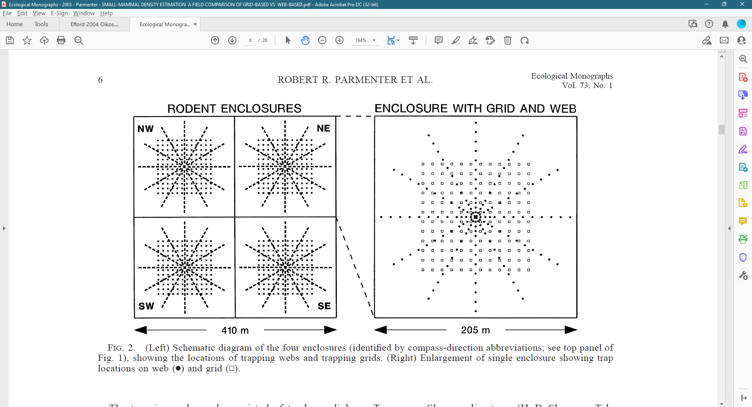
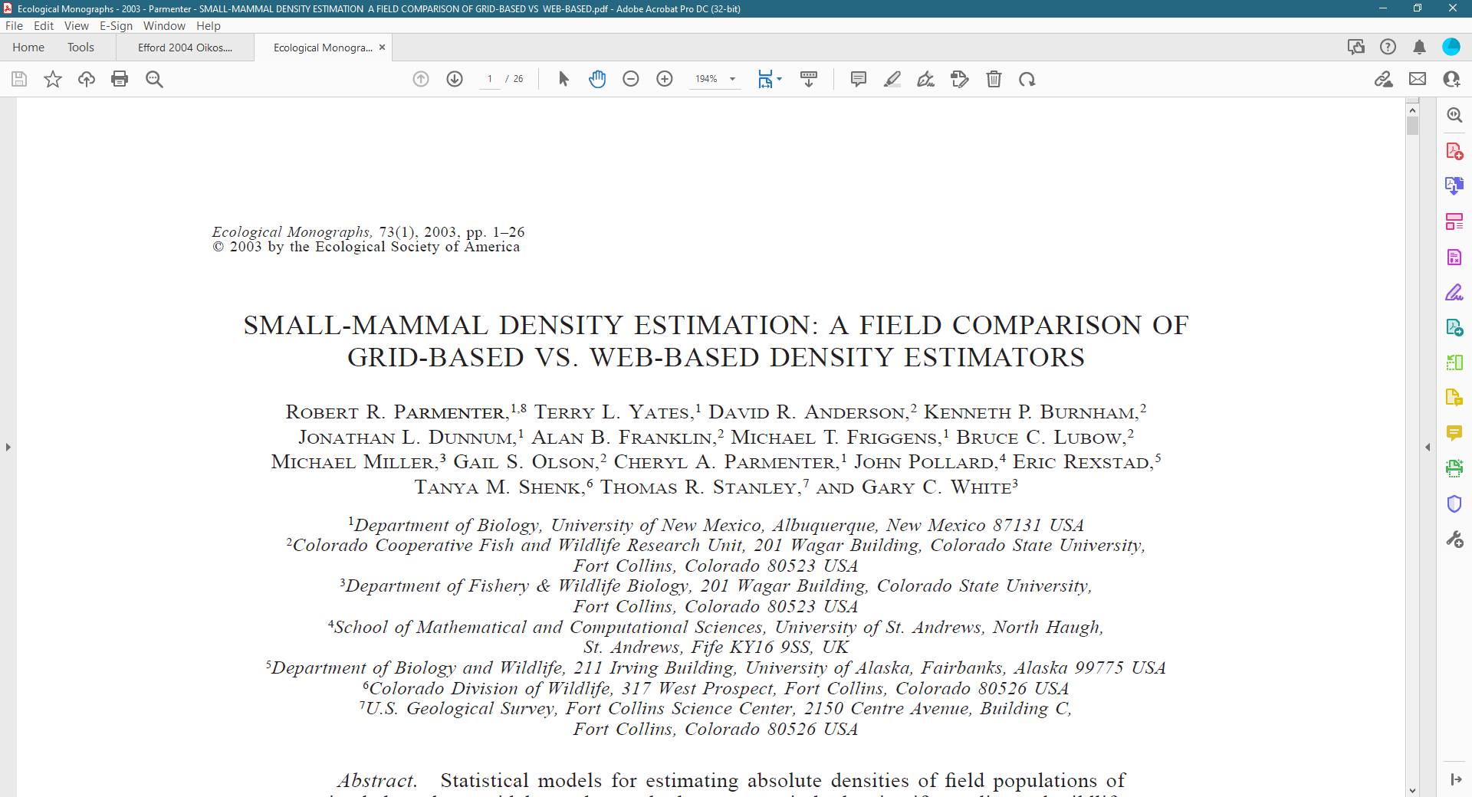

Slide 17
Lincoln-Peterson Estimation
The goal is to estimate how big the population is (N)
Do so in two steps
Capture some number of individuals, mark these individuals (M) and then release them
Capture a second set of individuals (C) and count how many are marked (R)
Assume that all individuals are equally likely to be captured in either time period

Slide 18
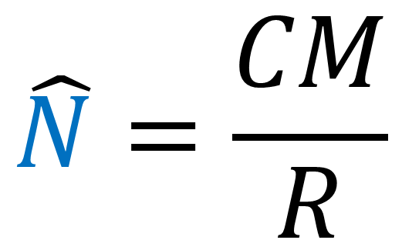
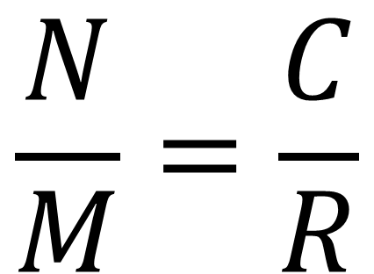
Lincoln-Peterson Estimation
N – population size
M – number of individuals marked during the first sampling period
C – number of individuals captured in the second sampling period
R – number of individuals captured in the second sampling period that were previously captured and marked
$$\frac{N}{M}=\frac{C}{R}$$
$$\hat{N}=\frac{CM}{R}$$

Slide 19
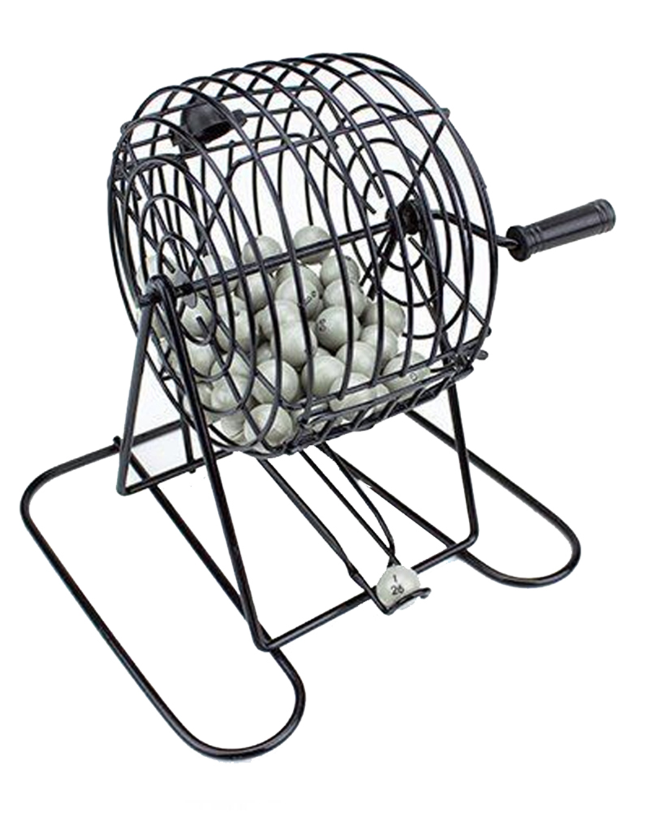

Slide 20
Lincoln-Peterson Estimation
N – population size
M – number of individuals marked during the first sampling period
C – number of individuals captured in the second sampling period
R – number of individuals captured in the second sampling period that were previously captured and marked
$$\frac{N}{M}=\frac{C}{R}$$
$$\hat{N}=\frac{CM}{R}$$

Slide 21
Lincoln-Peterson Estimation
15 individuals trapped during each of two trapping events
Individuals “marked” during first event (write down “ID”) and then released back into the population
Calculate C, M, and R from your trapping records
Estimate N given the equation N=(CM)/R
Repeat this for 10 individuals
How does this compare to the calculation from 15?

Slide 22
Lincoln-Peterson Estimation
Rarely sufficient for population estimation
Apply same general rationale to trapping over several attempts

Slide 23
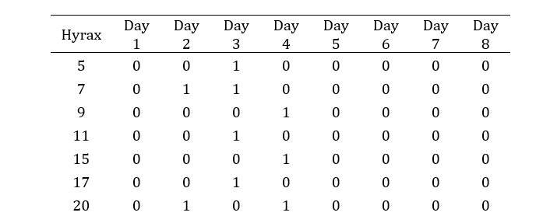
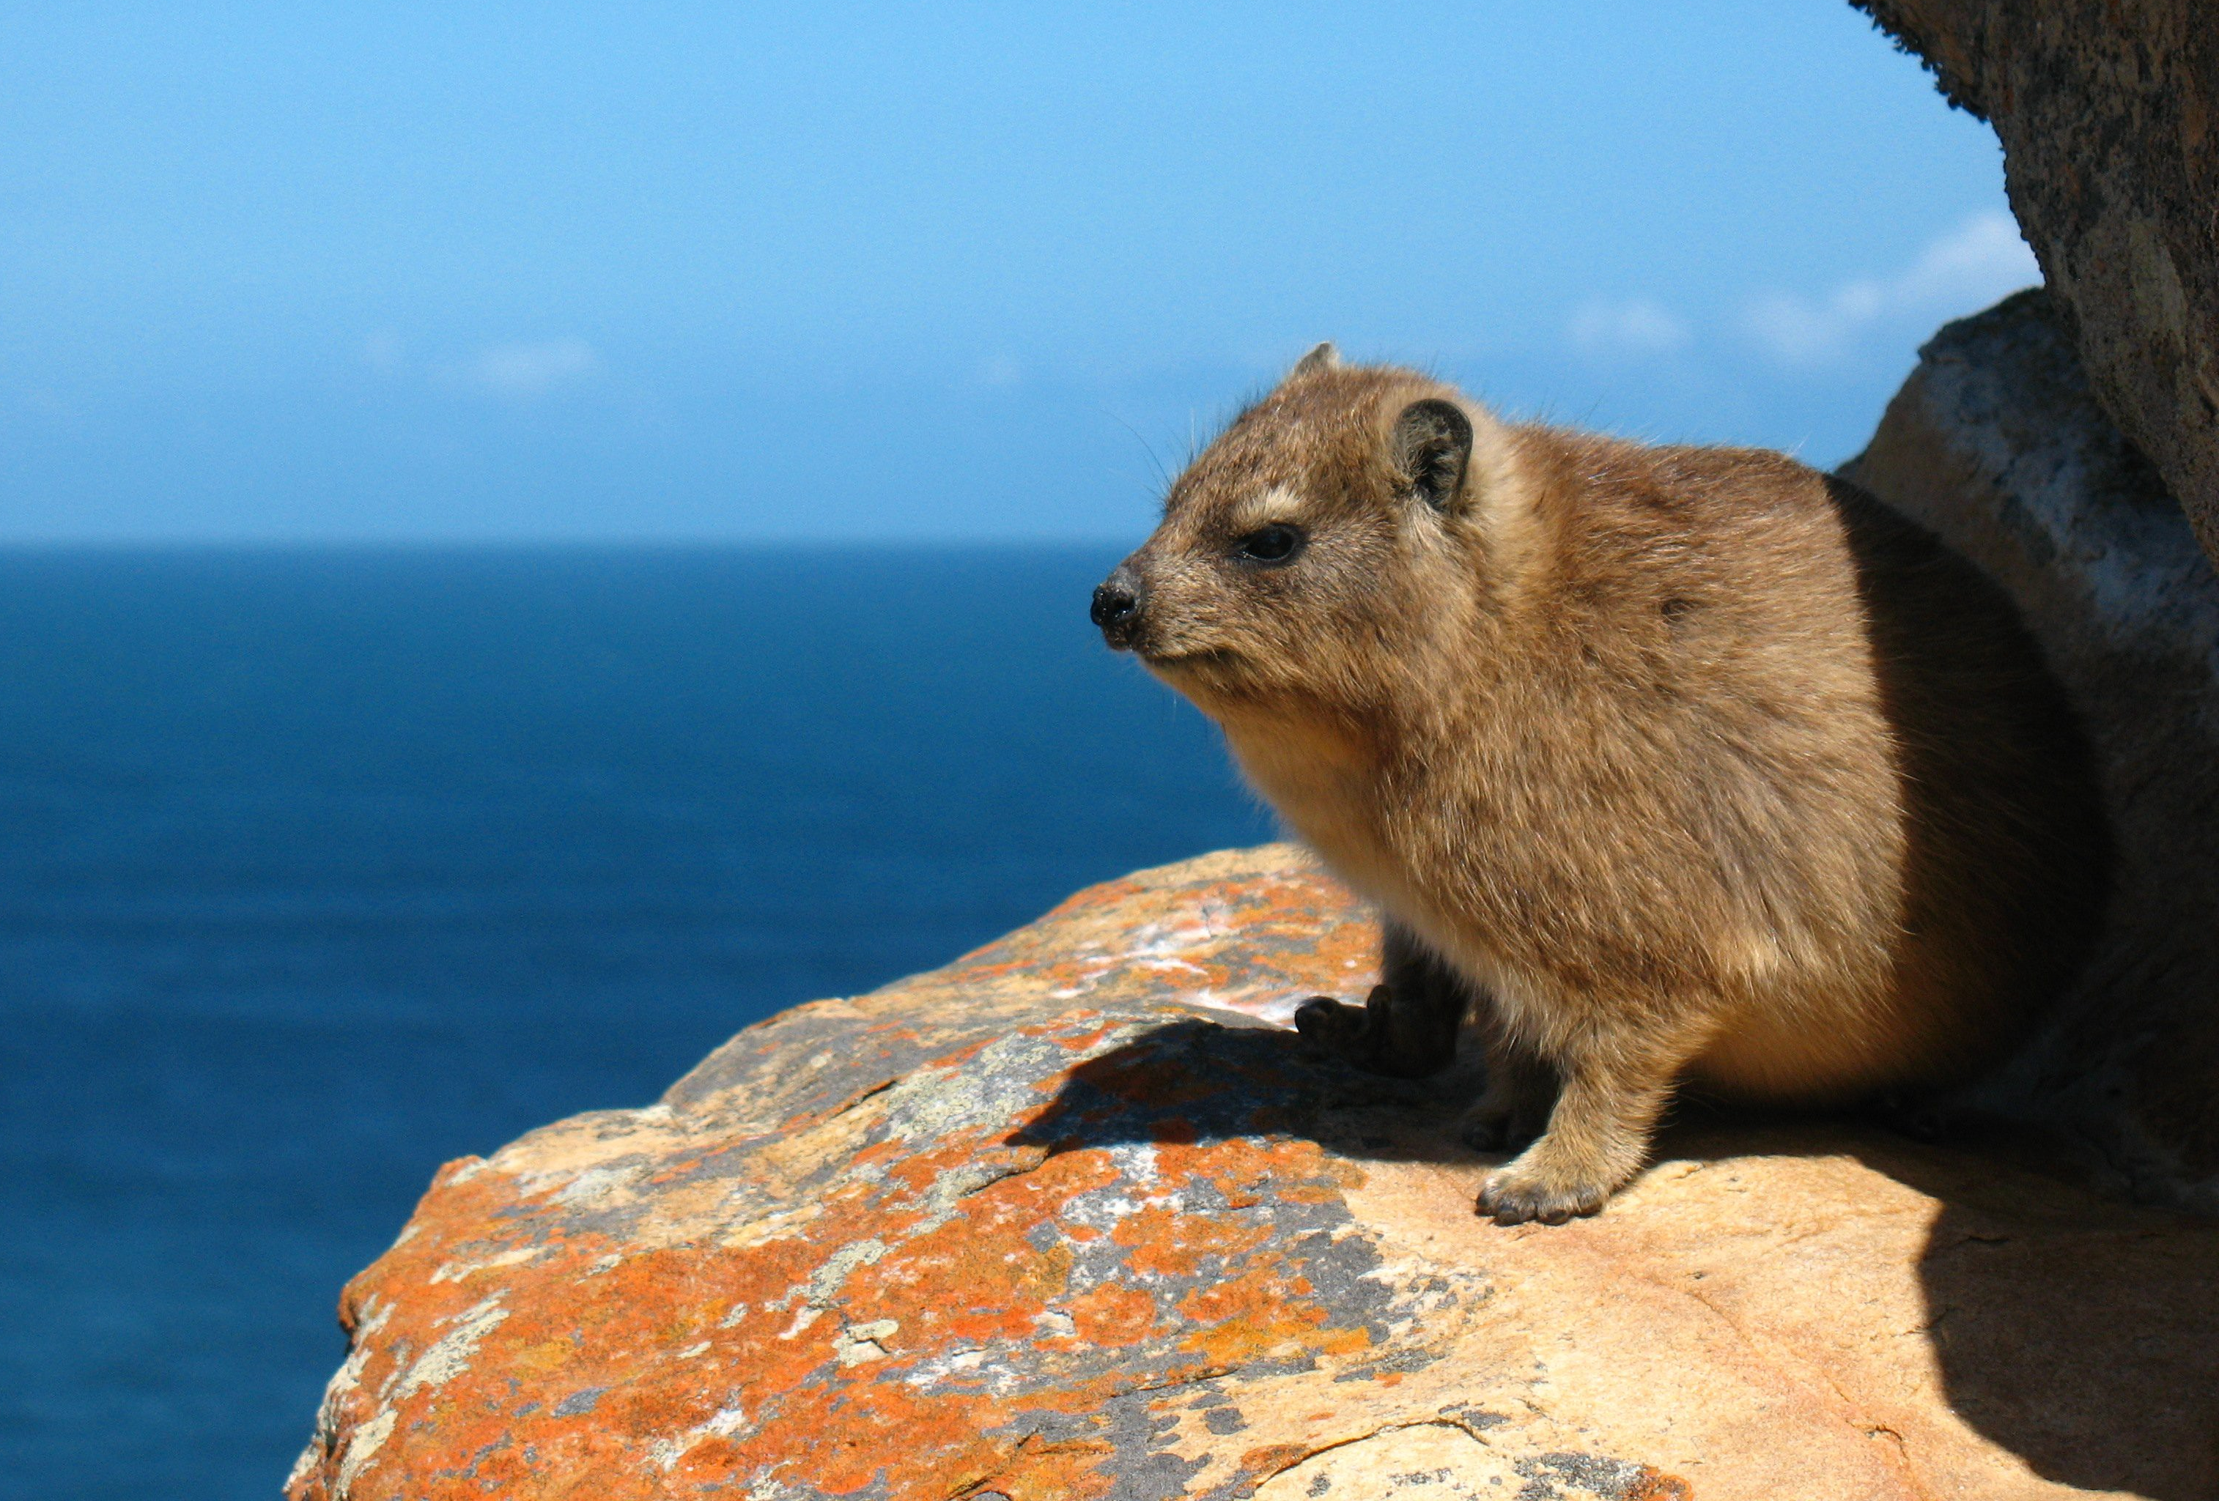
Capture Histories
Rock Hyraxes

Slide 24
How many species are present in an area?
Any of the prior methods can also be used for this question
What is the minimum amount of sampling needed?

Slide 25
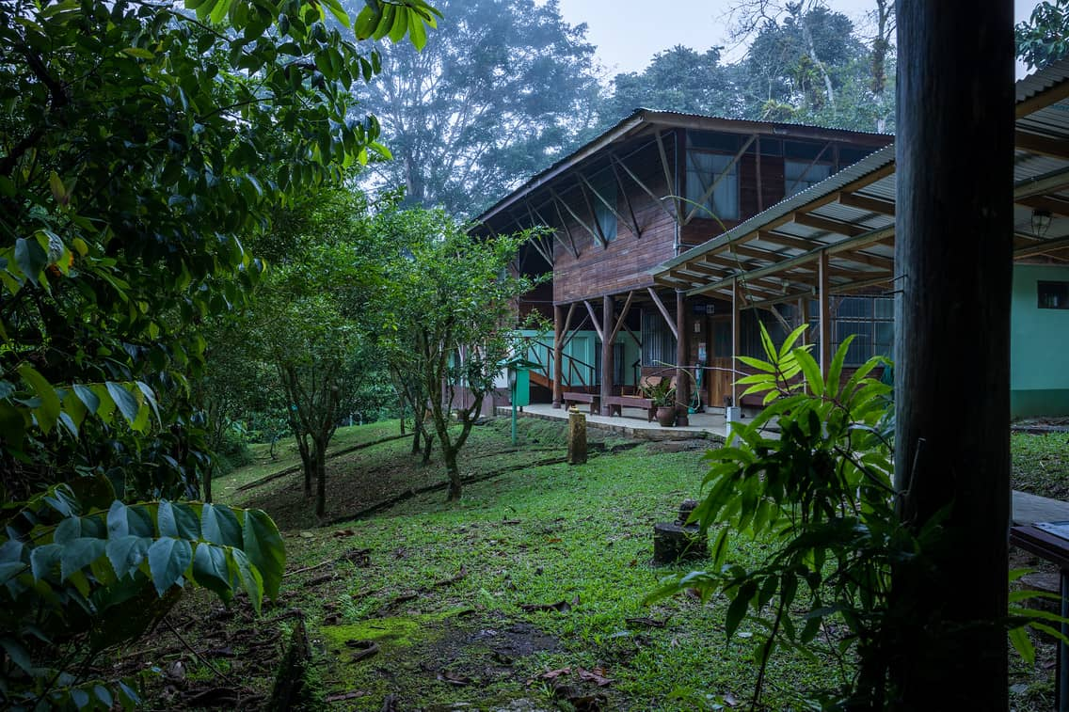

Slide 26


Slide 27
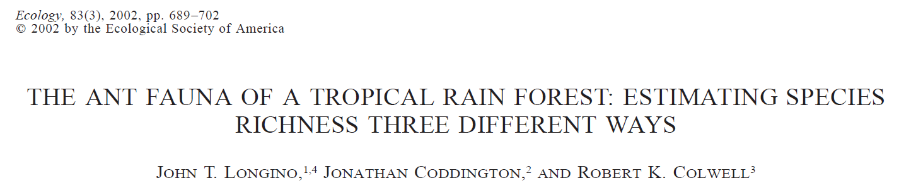
~440 species of ants

Slide 28
Estimating species numbers
Repeatedly sample and identify species
Identify number of unique species collected
Continue collecting until it’s clear there will be no change or statistically estimate number of species
Species accumulation curve, collector’s curve

Slide 29
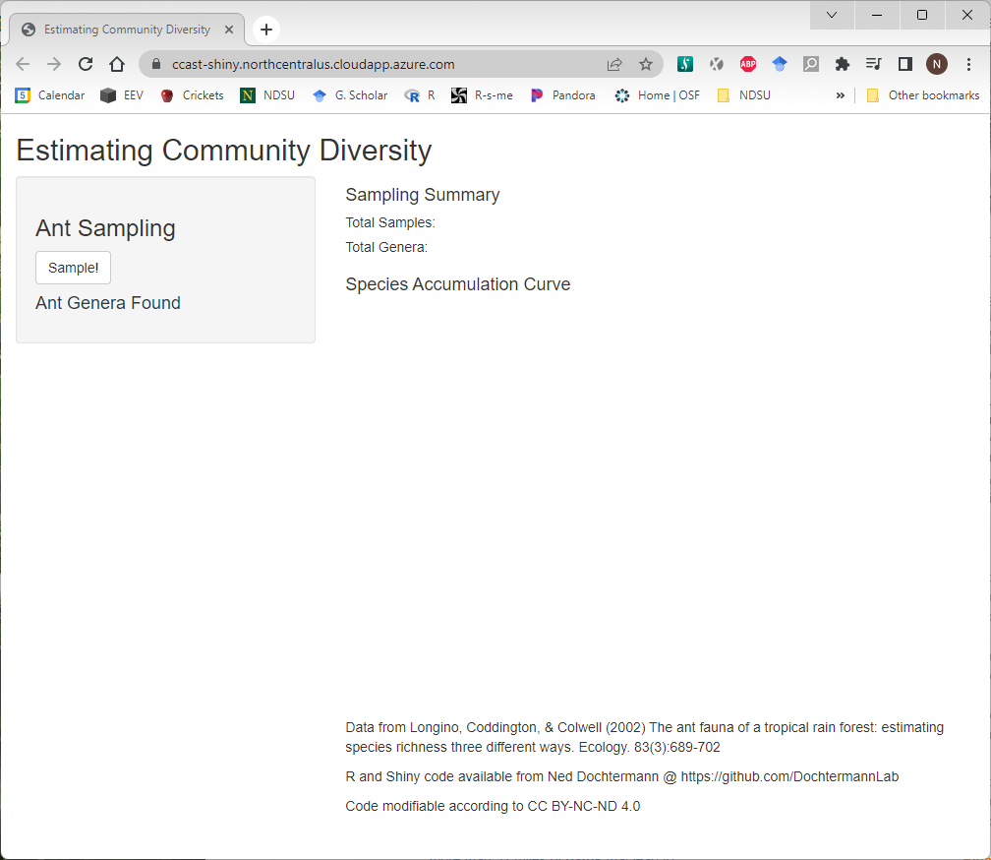
Notes:
https://ccast-shiny.northcentralus.cloudapp.azure.com/

Slide 30
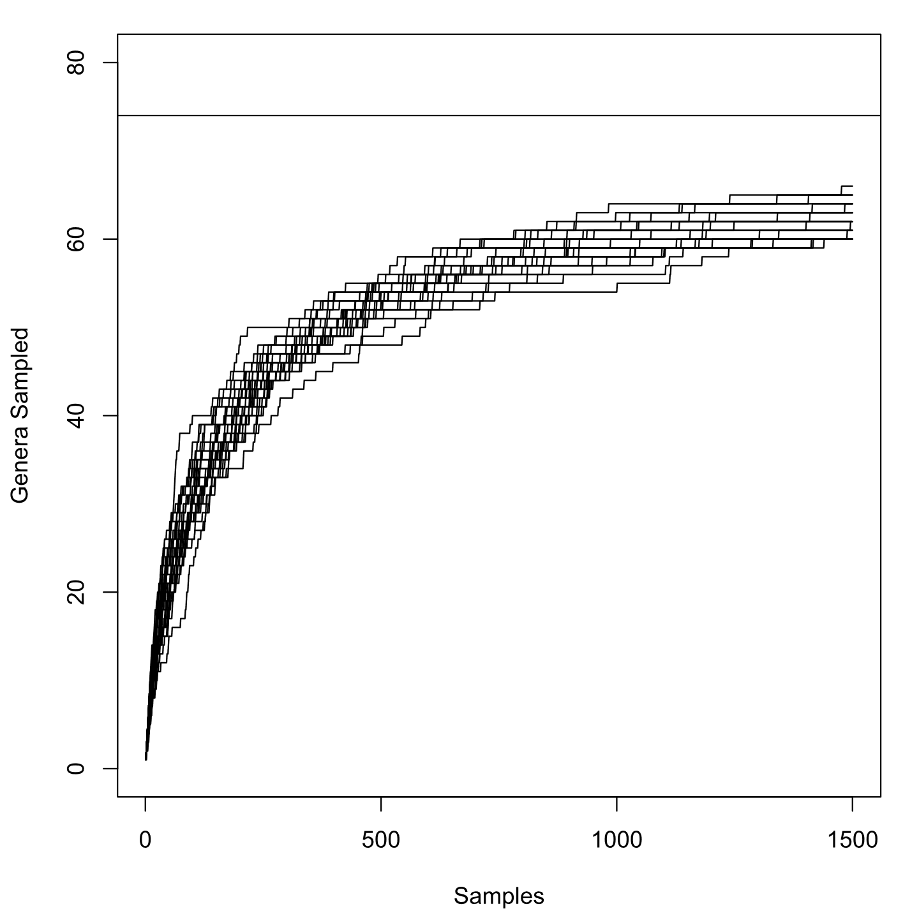

Slide 31
Relative Representation
Notes:
…even with same species/genera present, still can have communities that are very different.

Slide 32
(Classic) Measures of community composition
Richness
Number of species present
Diversity
Number of species present and number of each
Probability that any two random individuals are members of the same species
Evenness
How close a community is to equal representation across species

Slide 33
Diversity at different spatial scales
Alpha (α) Diversity (or richness)
Average species diversity (or richness) within patches
Beta (β) Diversity (or richness)
Between patch variation in diversity (or richness)
Gamma (γ) Diversity (or richness)
Region-wide species diversity (or richness)

Slide 34
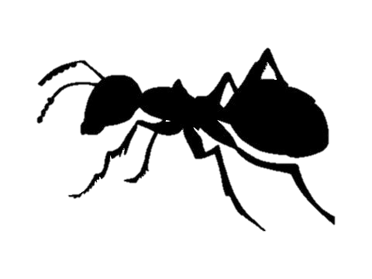
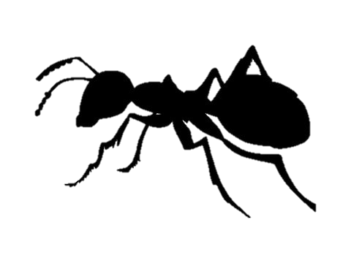
α = 3
C
A
β = 5
β = 5
(3-1) + (4-1)
α = 5
(4-2) + (5-2)
γ = 8
B
α = 4

